Slide 1

ROBO ADVISOR Lite
Project 1

Slide 2
Project Details
Provide a platform for User input of 5 ASX stocks
Perform Data Analysis and Forecast Returns
Understanding Market Dynamics & Sector Performance
Risk VS Return
Effective risk management
Data sampling & Monte Carlo
Take emotion out of investing decisions

Slide 3
Project Scope
5 stocks
historical data ( 5y) for each input ticker ( restrict to 5)
Weight - 5 random runs ( Monte Carlo)
Top 5 performing ASX Companies
Top 5 performing sectors
Send email with final report

Slide 4

Yahoo Finance
Open Source YFinance & Yahoo Financials Libraries
Free API

Slide 5
Quantitative Analysis
Data Source
Data Clean-up
Standardised Risk based on Recent Historical Data

Slide 6
Python, Pandas, HV Plot & Streamlit
Open Source

Slide 7
Monte Carlo Simulation
Risk Analysis
Probability Distribution & Probabilistic
Uncertainty in variable of risk analysis

Slide 9
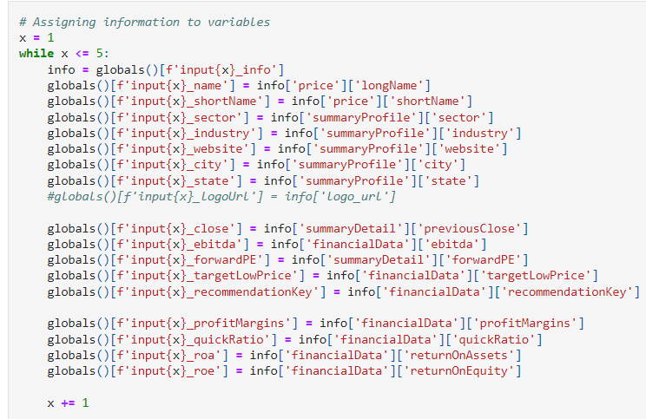
Data Retrieval

Slide 10
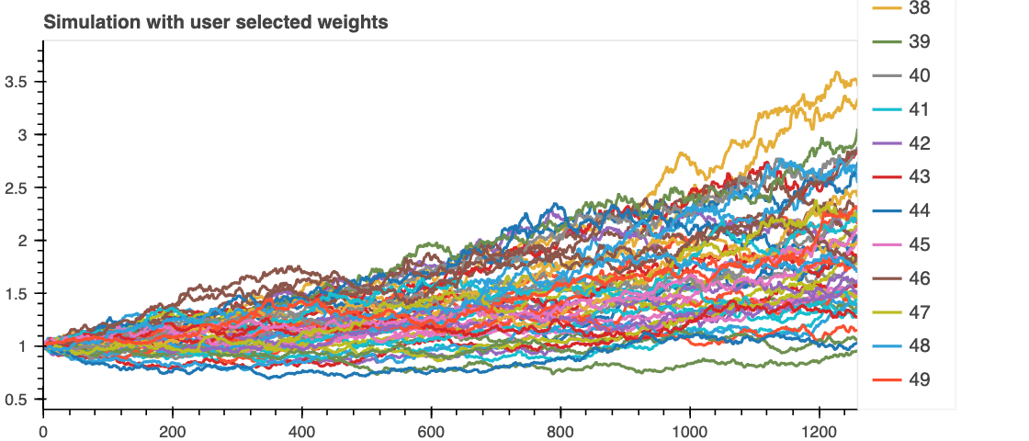
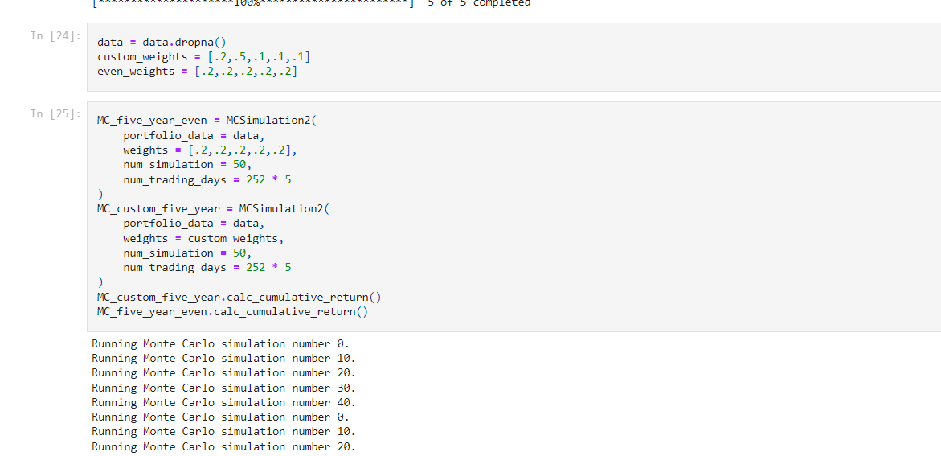
Monte Carlo Simulation

Slide 11
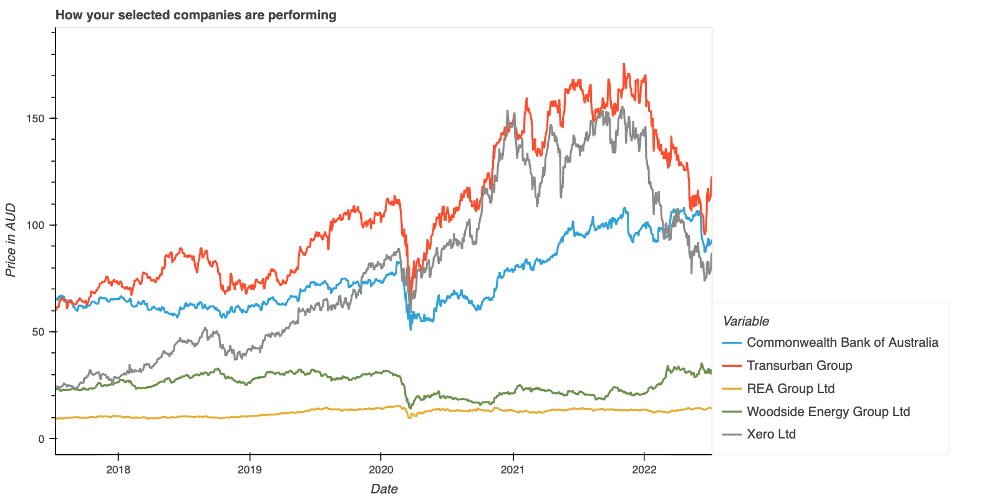
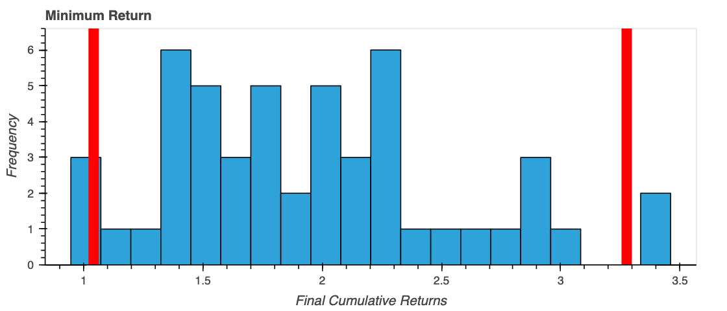
5 Year Performance of Selected Stock

Slide 12
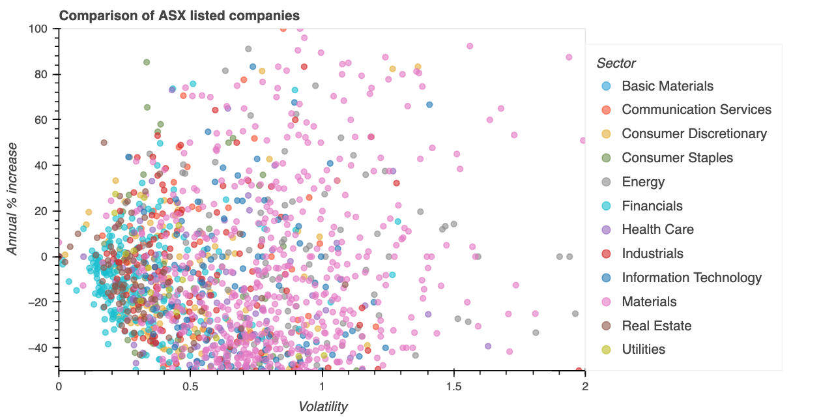
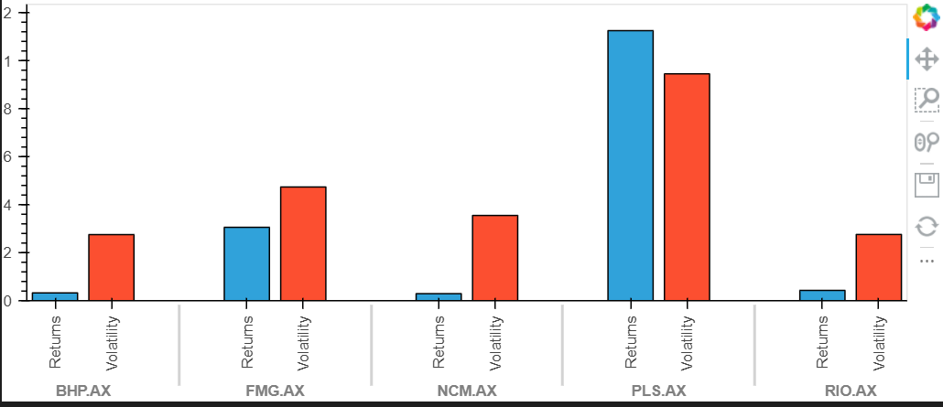
Risk vs Return

Slide 13
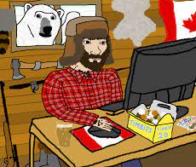




Team
Adam Westlake
Ganesh Bashyal
Garry Comber
Michael Blauberg
Manpreet Singh

Slide 14
Project Highlights
Finance
Python
Pandas and HVPlot
Teamwork

Slide 15
Challenges
Yahoo Finance’s Multilevel Data Slow speed, access limitations
Code length & Data Size
Streamlit Integration

Slide 16
Challenges
Yahoo Finance Library
Pandas Limitations
Add text, images, art, and videos.
Add transitions, animations, and motion.
Save to OneDrive, to get to your presentations from your computer, tablet, or phone.
Open the Design Ideas pane for instant slide makeovers.
When we have design ideas, we’ll show them to you right there.

Slide 17
Challenges
Data Analysis
subtitle
subtitle
Add text, images, art, and videos.
Add transitions, animations, and motion.
Save to OneDrive, to get to your presentations from your computer, tablet, or phone.
Open the Design Ideas pane for instant slide makeovers.
When we have design ideas, we’ll show them to you right there.
Add text, images, art, and videos.
Add transitions, animations, and motion.
Save to OneDrive, to get to your presentations from your computer, tablet, or phone.
Open the Design Ideas pane for instant slide makeovers.
When we have design ideas, we’ll show them to you right there.
Add text, images, art, and videos.
Add transitions, animations, and motion.
Save to OneDrive, to get to your presentations from your computer, tablet, or phone.
Open the Design Ideas pane for instant slide makeovers.
When we have design ideas, we’ll show them to you right there.

Slide 18

Summary
Successfully implemented a data acquisition and perform a Quantitative Analysis based on a given set of choices of ASX securities and their initial weights.

Slide 19


Thank You
Team 3
Adam Garry Ganesh Manpreet Michael

